Slide 1

‘’Recognition of Handwritten
Köktürk Digits’’
CSE4088 Intoduction to Machine Learning
Project Presentation
Hilal EKİNCİ – Oğuzhan BÖLÜKBAŞ

Slide 2
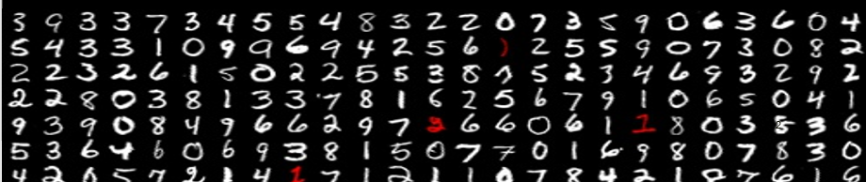
Handwritten Digit Recognition
Handwriting recognition (HWR) is the ability of a computer to receive and interpret intelligible handwritten input from sources such as paper documents, photographs,touch-screens and other devices [1]. Handwritten recognition is also applied for handwritten digits. The MNIST database (Modified National Institute of Standards and Technology database) [2] is a large database of handwritten digits that is commonly used for training various image processing systems. The database is also widely used for training and testing in the field of machine learning.

Slide 3
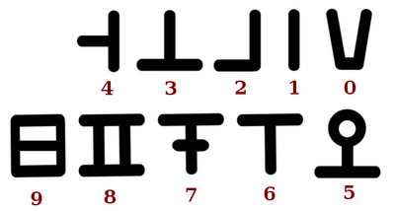
Köktürk Digits
Köktürks were the Turkish lineage who lived as a sovereign nation under the name Köktürk State in Ötüken, Central Asia between AD 552-745[3]. They used different alphabet and numbers which is not similar to Turkish alphabet and digits we currently use.
Köktürk digits [4]

Slide 4
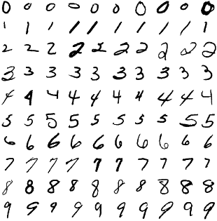
Goals
Building a dataset of handwritten Köktürk digit recognition
Implementing a convolutional neural network (CNN)
Obtaining at least 90% accuracy

Slide 5
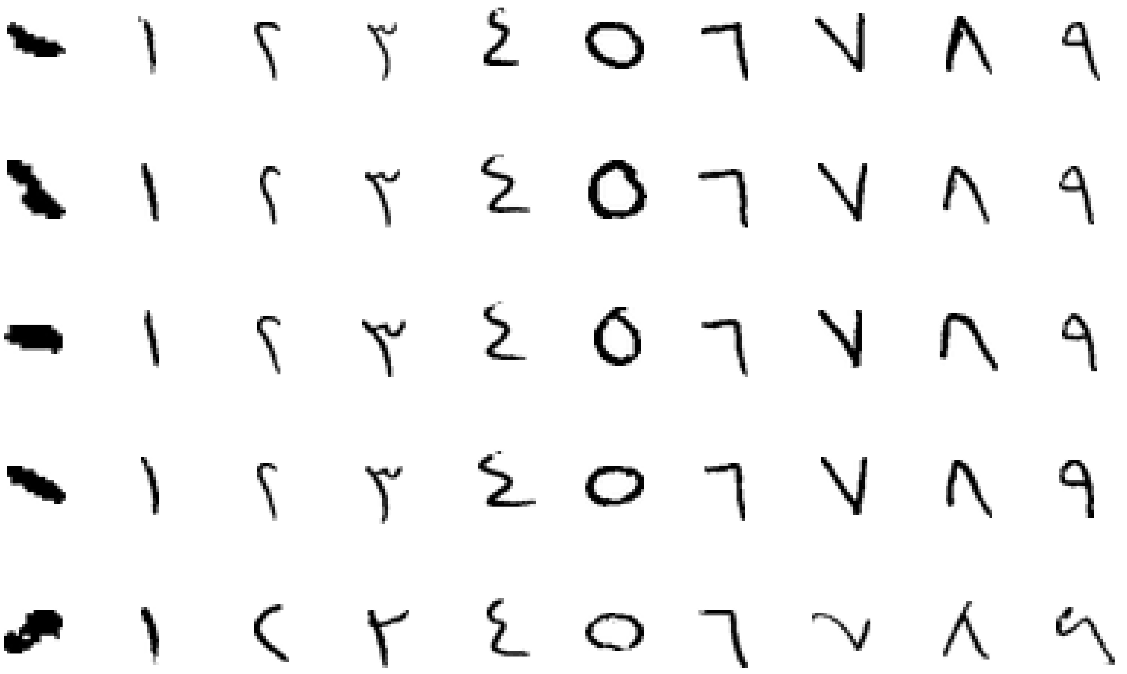
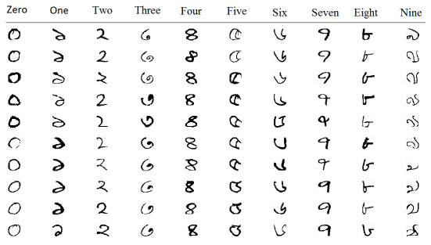
Related Work
Azeem S., Meseery M. and et al.Online Arabic Handwritten Digits Recognition [5]
Training Dataset: 30000
Testing Dataset: 900
Method: Multi-class Nonlinear SVM
Accuracy: 98.73%.
Alom Z., Asari V. and et al. Handwritten Bangla
Digit Recognition Using Deep Learning [6]
Training Dataset: 5000
Testing Dataset: 1000
Method: CNN
Accuracy: 98.64%

Slide 6
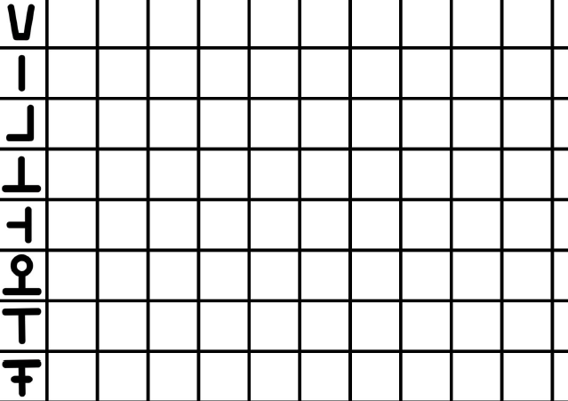
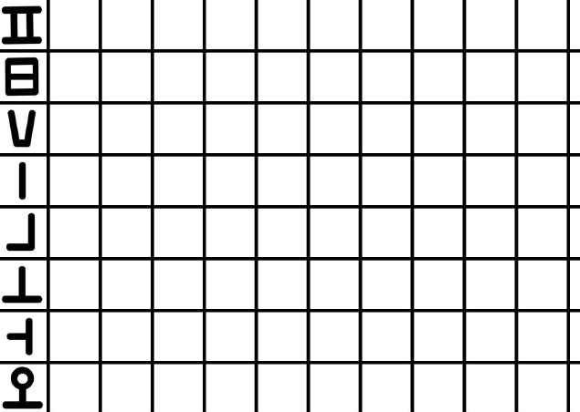
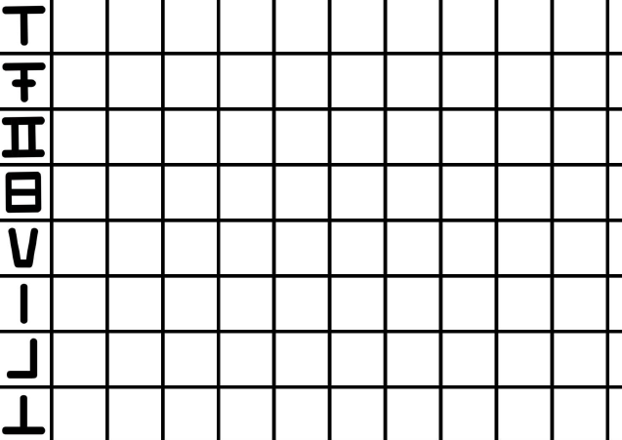
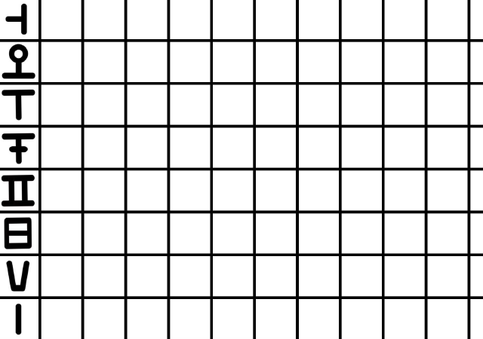
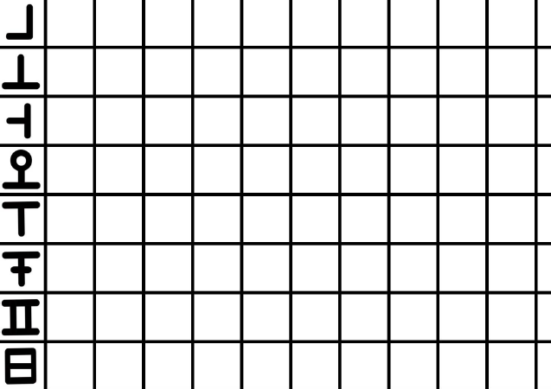
Building a dataset – Phase 1

Slide 7
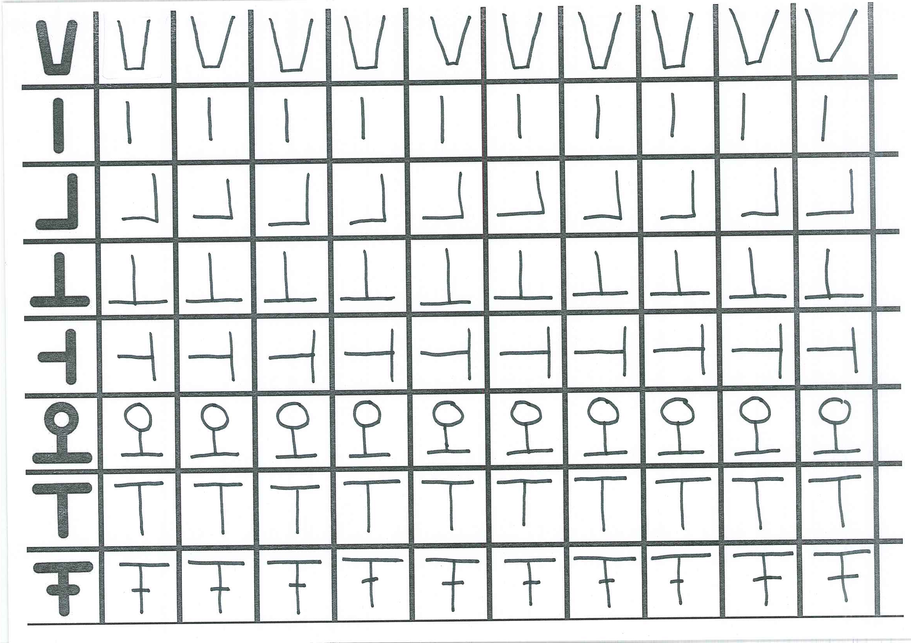
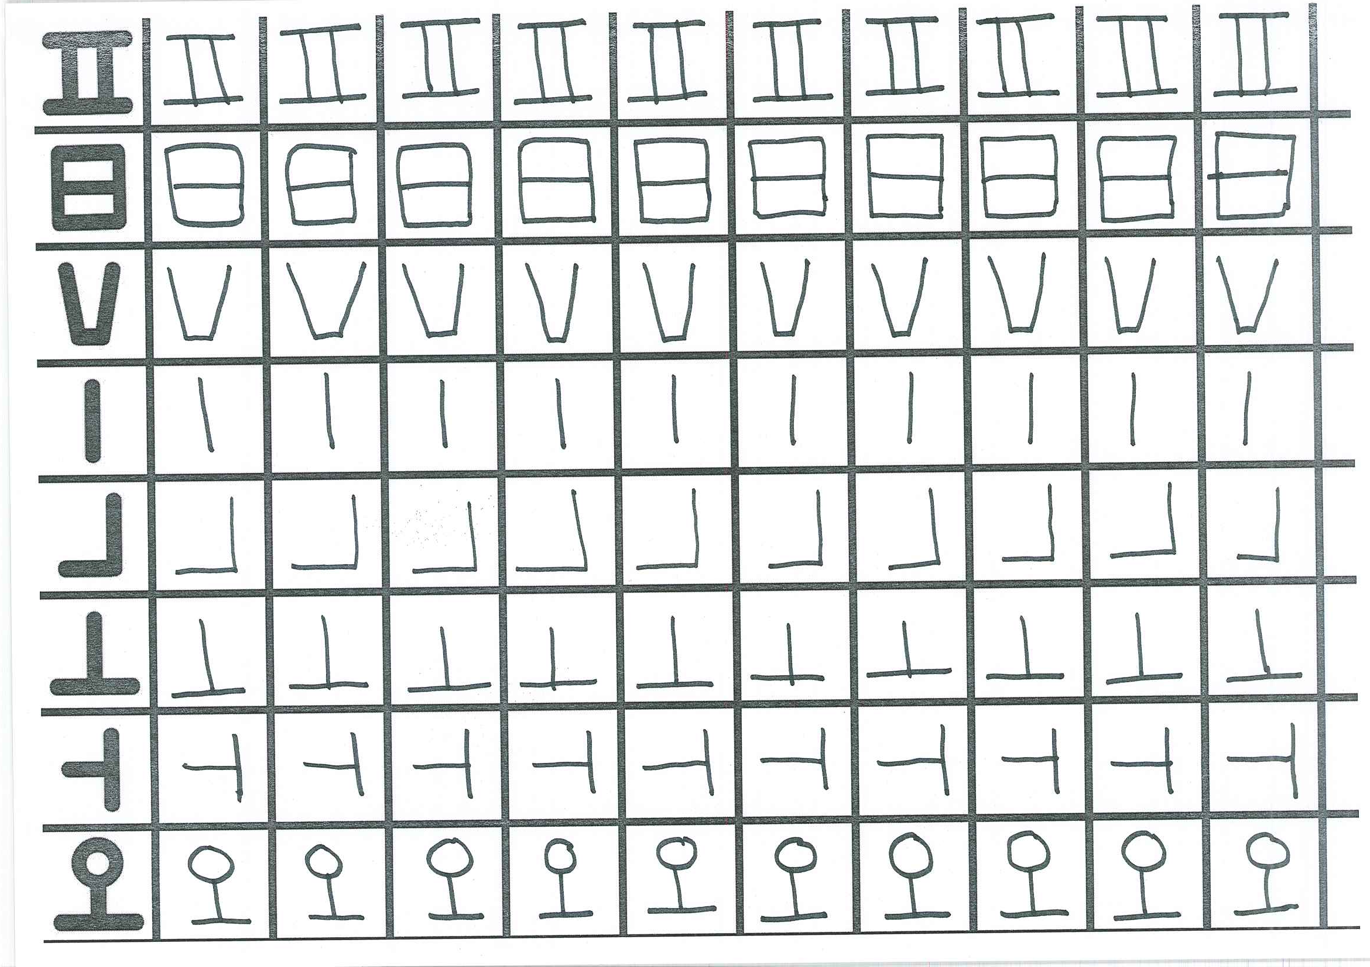
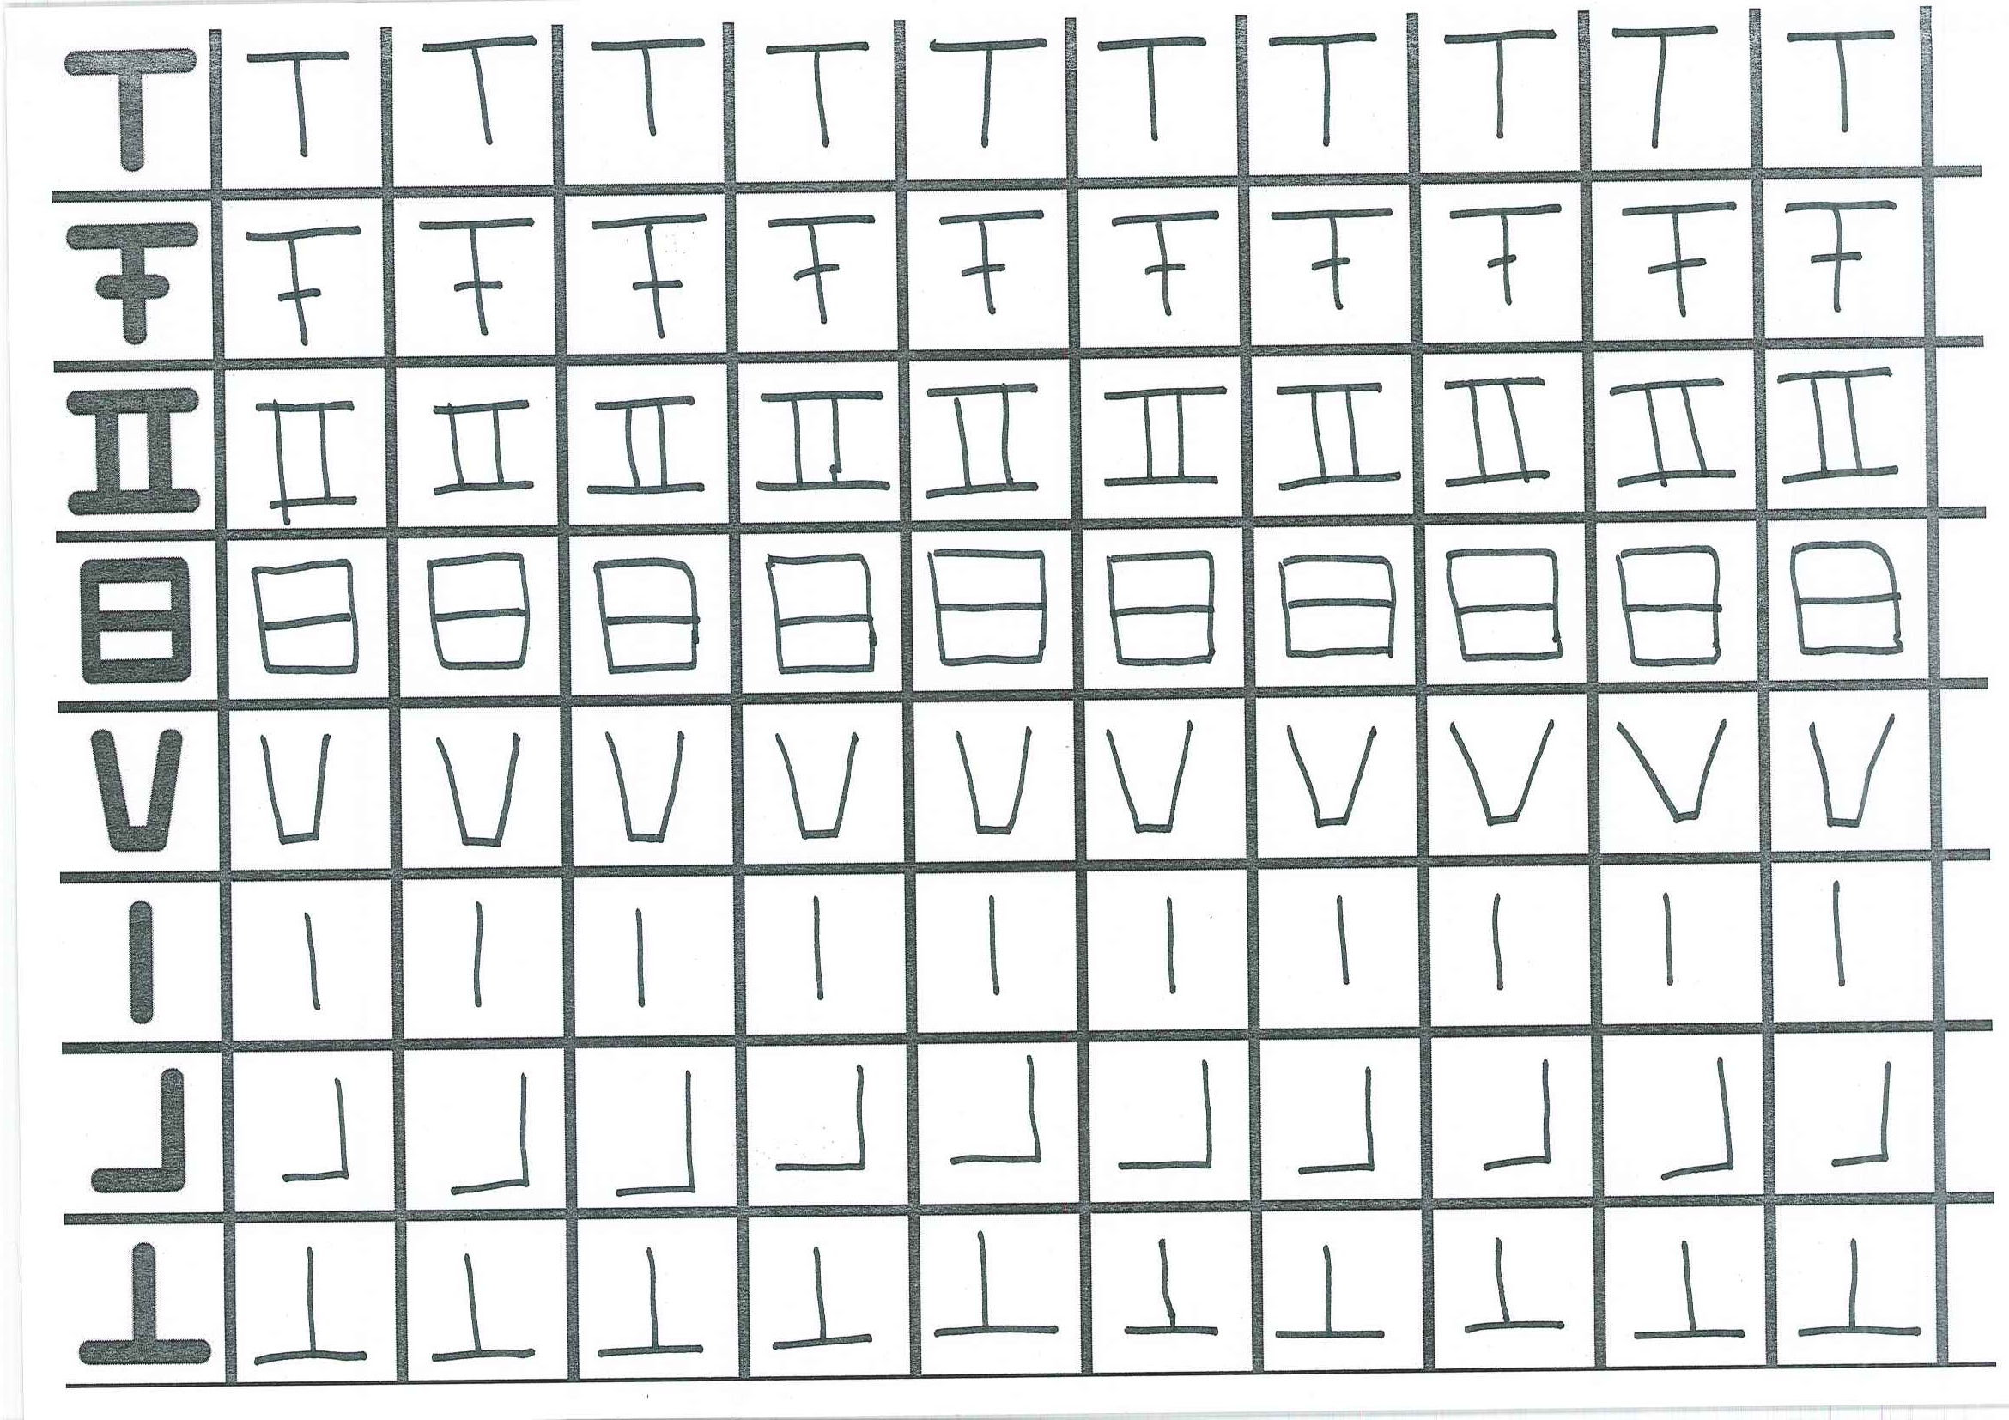
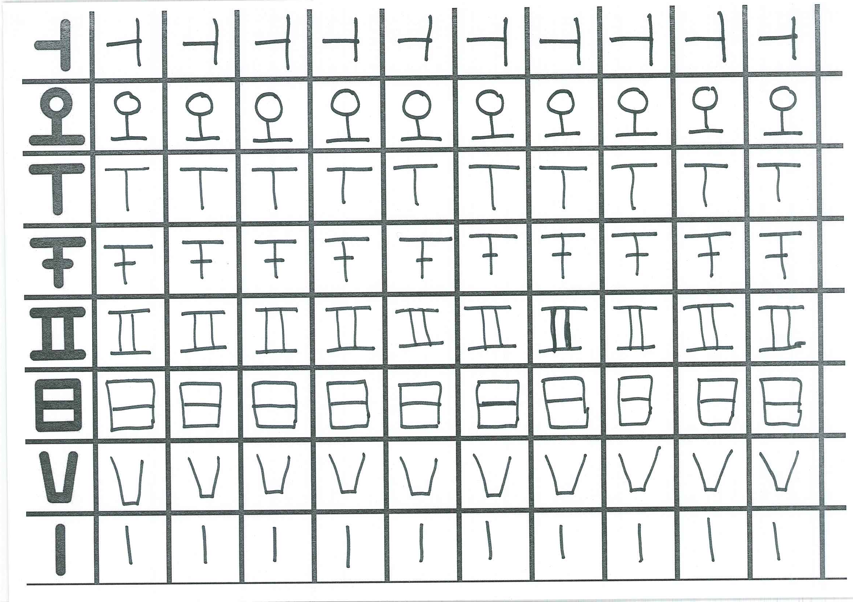
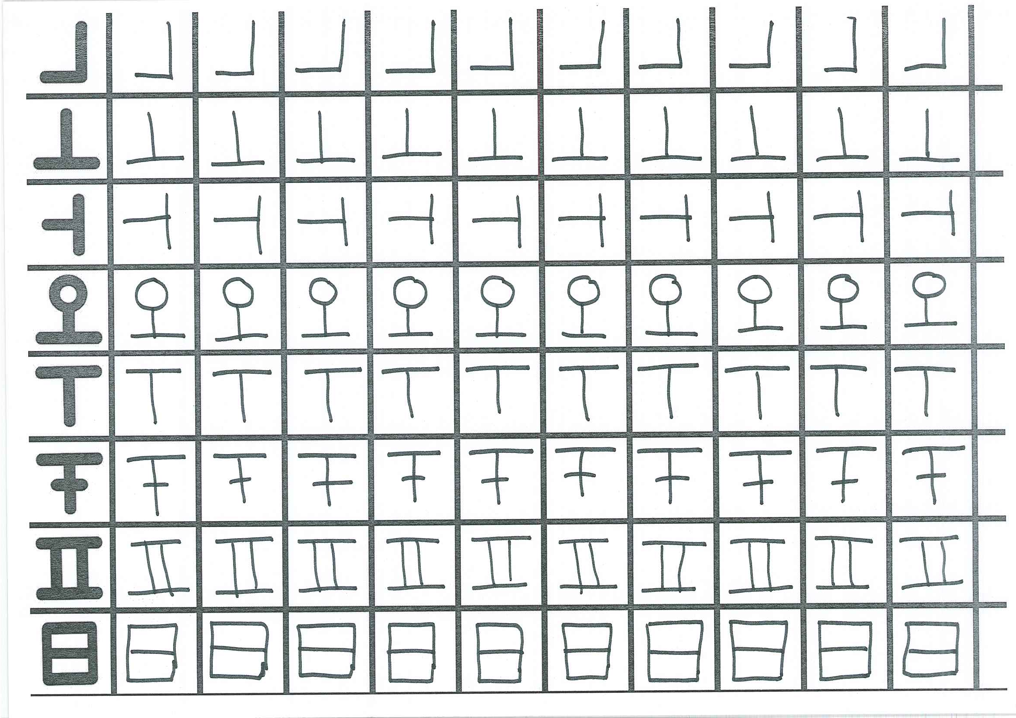
Building a dataset – Phase 2

Slide 8
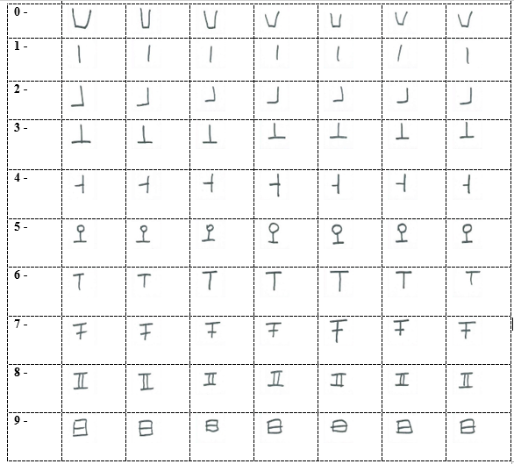
Building a dataset – Phase 3

Slide 9
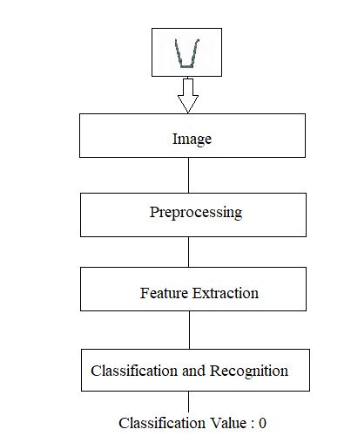
Method
We used convolutional neural network (CNN or CovNet) in this project because CNN is good for analyzing visual imagery. Firstly, we resize the training images to 28x28 pixels and convert them to grayscale images because the color is not important for this project. We used library of Pyhton Keras for recognition of Köktürk digits. We have 3 convolution layers and after 3 layers, a dropout layer is added to avoid overfitting problem.
Technologies used for this project
Python 3.6.6
JetBrains PyCharm Community Edition as Python IDE
Libraries: NumPy, OpenCV, Keras, Tensorflow

Slide 10
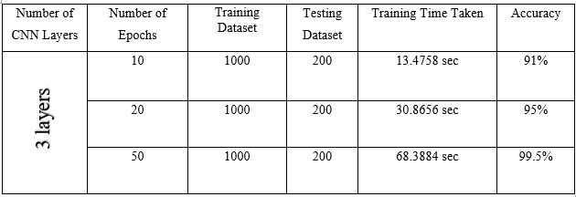
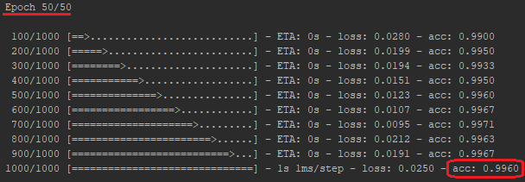
Experiments

Slide 11
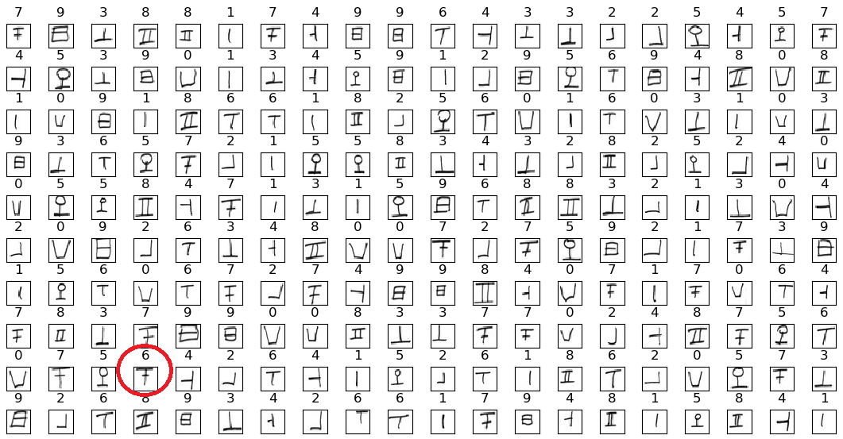
Results
We have a total of 1000 images as our training dataset including 100 samples from each class. We have a total of 200 images as our testing dataset including 20 samples from each class. Our program classified 199 images correctly out of 200 images. There was only a digit image misclassified, the program classified a digit with label ‘6’ instead of the actual value ‘7’. This means 99.5% accuracy we have obtained in our project.

Slide 12
References
[1] Handwritten recognition, Wikipedia [Online] Available: https://en.gowikipedia.org/wiki/Handwriting_recognition (Date of Access: 20.10.2018)
[2] MNIST database, Wikipedia [Online] Available: https://en.gowikipedia.org/wiki/MNIST_database (Date of Access: 16.10.2018)
[3] Köktürkler, Wikipedia [Online] Available: https://tr.wikipedia.org/wiki/Göktürk_Kağanlığı (Date of Access: 16.10.2018)
[4] Blog of Researches on Köktürk Digits, [Online] Available: http://kokturukce.blogspot.com/2008/09/trk-saylar.html (Date of Access: 16.10.2018)
[5] Azeem S., Meseery M. and et al.Online Arabic Handwritten Digits Recognition [Online] Available at: http://www.iapr-tc11.org/archive/icfhr2012/paper021.pdf (Date of Access: 25.12.2018)
[6] Alom Z., Asari V. and et al,Handwritten Bangla Digit Recognition Using Deep Learning [Online] Available at: https://arxiv.org/pdf/1705.02680.pdf (Date of Access: 25.12.2018)

Slide 13
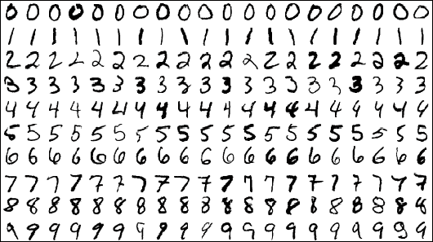
Thanks for listening
https://github.com/hilalekinci/Introduction-to-Machine-Learning-Recognition-of-Handwritten-Kokturk-Digits

